Slide 1
Password-Protected & Encrypted QR Code System
Developed by: Dhyeya Choksi (23BIT055)
Parv Naik (23BIT056)
Tejas Singh (23BIT057)

Slide 2
Objectives
A QR-based system for securely encoding and decoding messages using Double Columnar Transposition Method.
Integrates encryption and password protection mechanisms.
Generates QR codes for secret messages that can only be decrypted with the correct password.

Slide 3
System Architecture
Input Interface – Accepts message, filename, and password.
Encryption Module – Performs double columnar transposition using one-halves of the password & password modification.
QR Code Generator – Creates QR image using qrcode library.
QR Code Decoder – Reads QR image via pyzbar.
User Input Encryption QR Generator QR Image
QR Decoder Decryption Output Message

Slide 4
Module 1: QR Code Encryption
Functions:
create_blank_matrix(): Initializes empty matrix.
create_letter_matrix(): Fills letters row-wise.
key_generator(): Creates a key for columnar transposition using password.
columnar_transposition(): Encrypts message.
qr_generator(): Generates and saves QR image.
Libraries Used:
qrcode

Slide 5
Algorithm: Encryption Flow
User inputs plaintext, filename, and 8-character password.
Password and message is combine so that password checker can be used during decryption.
Application of double columnar transposition (4 columns) using both halves of the 8-character password.
QR code generation using the obtain cipher text.

Slide 6
Module 2: QR Code Decryption
Functions:
decode_qr(): Reads QR code using pyzbar.
password_checker(): Verifies password validity.
columnar_decryption(): Reconstructs original text.
main(): The main function which uses other functions for the decryption.
Libraries Used:
pyzbar
PIL

Slide 7
Algorithm: Decryption Flow
Takes user input for QR filename and password.
Scanning QR image to extract encrypted text.
Uses password to decrypt the cipher text that has been encrypted using Double Columnar Transposition.
Separates the QR password from the decrypted text.
Compares this password with the user inputted password for validity.
If correct, displays the original message.

Slide 8
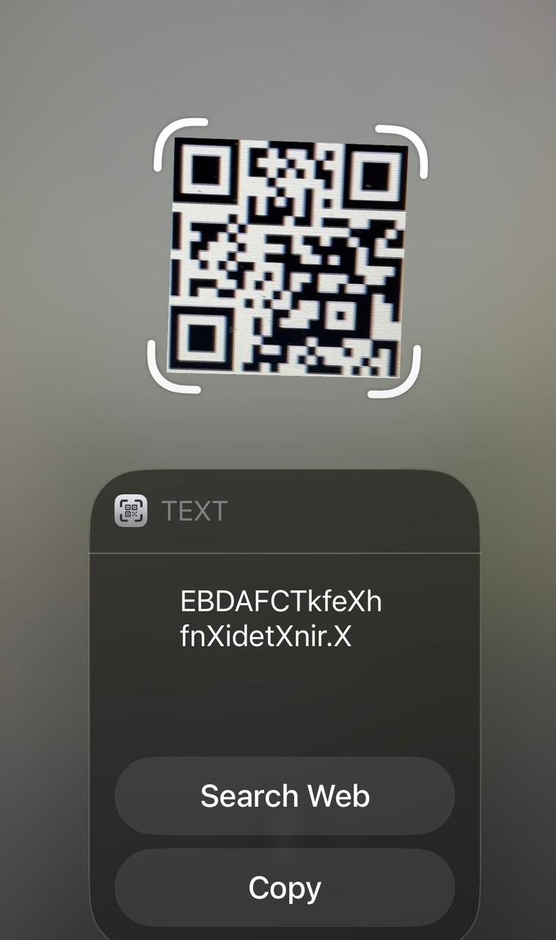
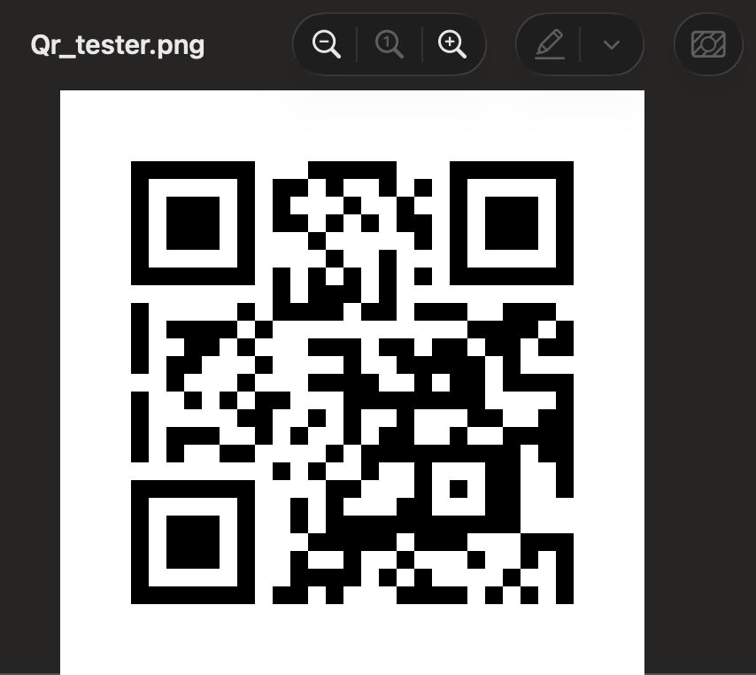
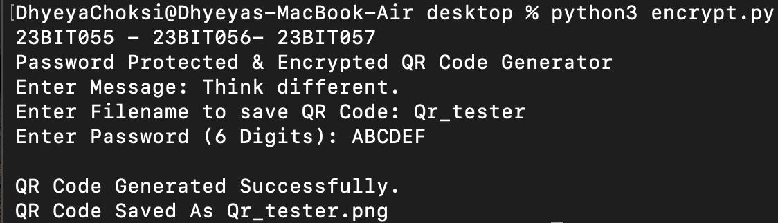
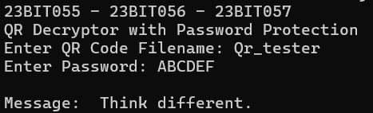
Results and Output
Successfully generated encrypted QR codes
Correct message retrieved only with valid password.
Encryption Process
QR Code
Scanning for encrypted text
Output

Slide 9
Conclusion and Future Scope
Conclusion:
Secure and simple encryption using Double Columnar Transposition and QR codes.
Protects message confidentiality using passwords.
Future Enhancements:
Use stronger encryption (e.g. AES).
Add better GUI or make a mobile application.
Create a support for multiple file types instead of just text.

Slide 10
Thank You!

